Slide 1
Capstone Project
Hotel Booking Analysis Team Members Anupam Mishra Kartike Animesh Chakraborty Pinaki Nandan

Slide 2

Let’s Analyse Hotel Booking
Data Exploration
Observe the Data
Find Missing
Data Cleaning
Replace the Null Values
Drop un-necessary columns
Analyse the data
Visualise the data
Conclusion

Slide 3

Fast Growing Ever Green Hotel Business
A hotel is an establishment that provides lodging, meals and other services for travelers and other paying guests.

Slide 4
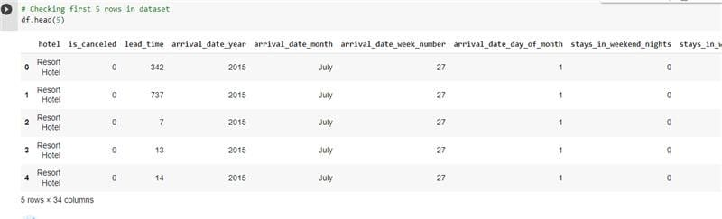
First Five Rows Data

Slide 5
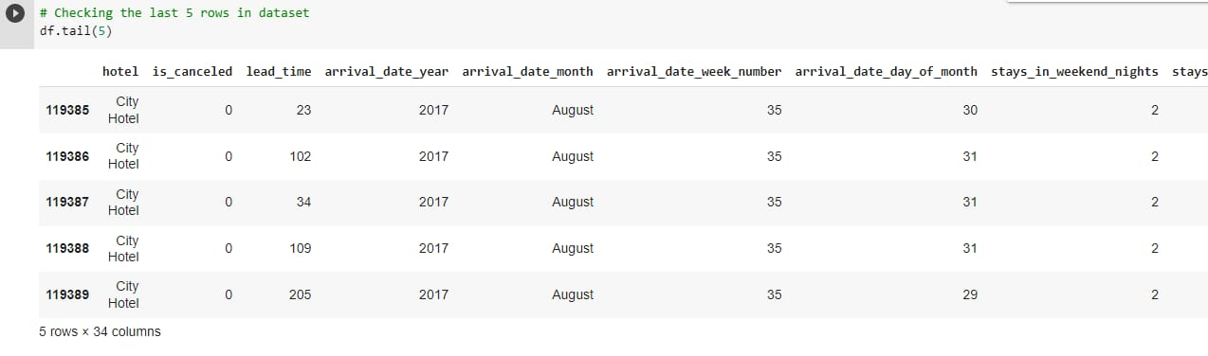
Last Five Rows Data

Slide 6
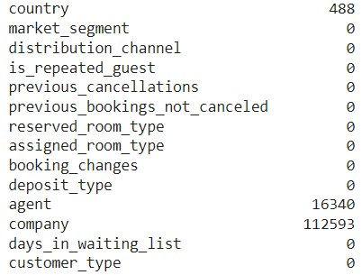
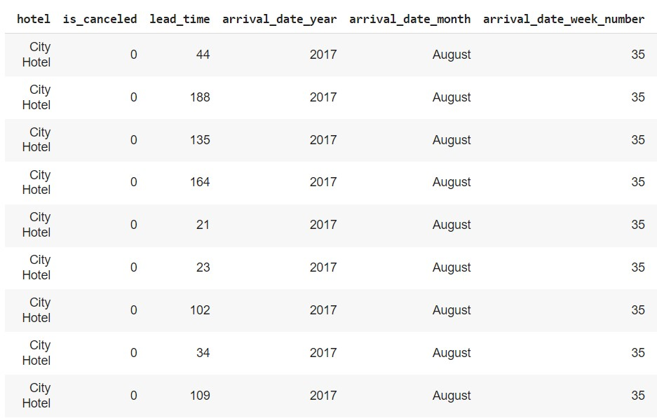
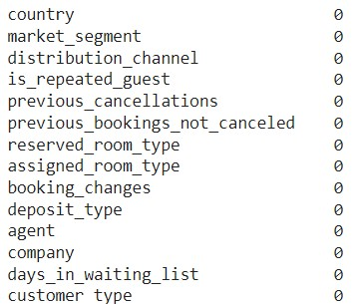
Explore The Dataset
Go Through The Dataset
Checking Null Values In Dataset
Replacing The Null Values With Their Mean

Slide 7
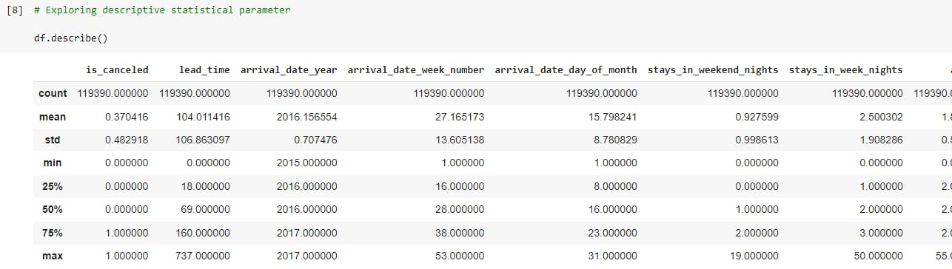
Description of the Data

Slide 8
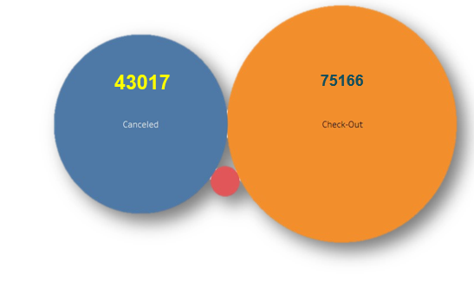
Canceled & Check-Out Booking
75166 customers are actually checked-out to the hotel
43017 customers are cancelling their bookings.
Due to this canceled bookings there will be an adverse effect on hotel business which means hotels are not able to make more profit, they are losing their customers.

Slide 9
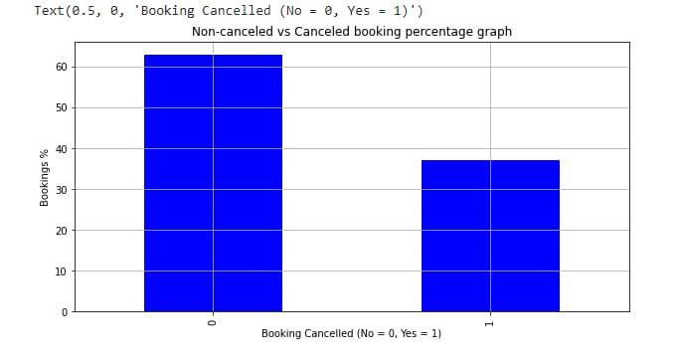
Non-Canceled vs Canceled Booking Percentage
As we saw total number of booking from our last slide, here we are going to see the same but in terms of percentage. This bar graph representing that 63% of customers are check-in to hotels where 37% of customers canceled their bookings.

Slide 10
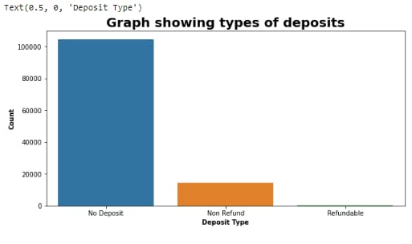
Deposit Policies Of Hotels
Very large amount of hotels have “No Deposit” Policy. And this may be the reason for cancellation of high amount of bookings. To avoid this booking cancellation, in account to collect more profit and customers- “No Deposit” policy should be change.

Slide 11
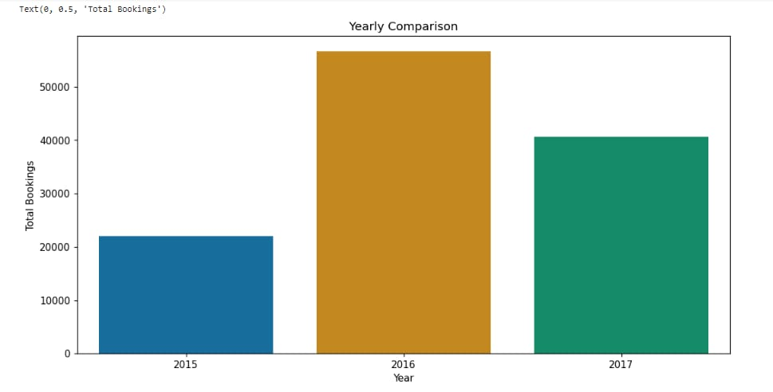
Total Number Of Bookings Across Different Years
How many customers actually checked-in to the hotel across different years?
Let us find out with simple bar chart, in 2015 there are 18.5% of customers checking in.
Whereas in 2016 we can see that there is increase in bookings up to 47.4%.
This increase in trend did not sustain for more time, going downward in 2017 with only 34.1% bookings.

Slide 12
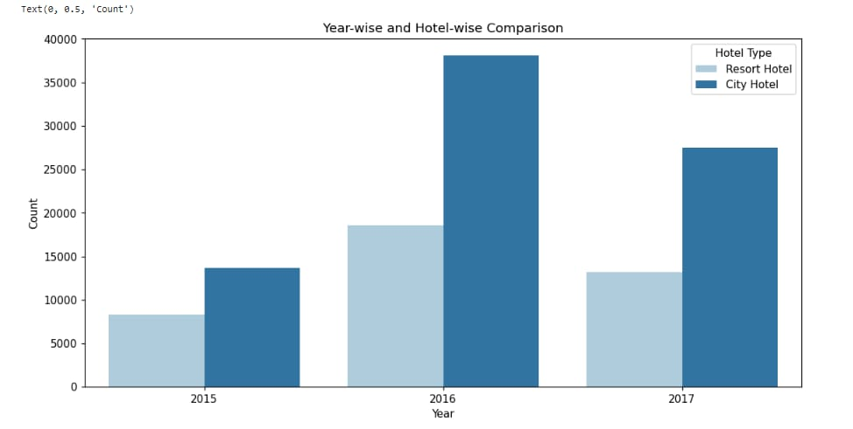
Demand Trend Of Hotels Year wise
Which type of hotels customer preferred to stay in different years?
Here, we plotted a subplot for Resort hotel and City hotel. From these columns we can conclude that there is always demand of City hotels as compared to Resort hotels across three different years 2015, 2016 and 2017. As we discussed early, after increasing the booking trend it got decreased again. This happened in both cases – Resort as well as for City hotels.

Slide 13
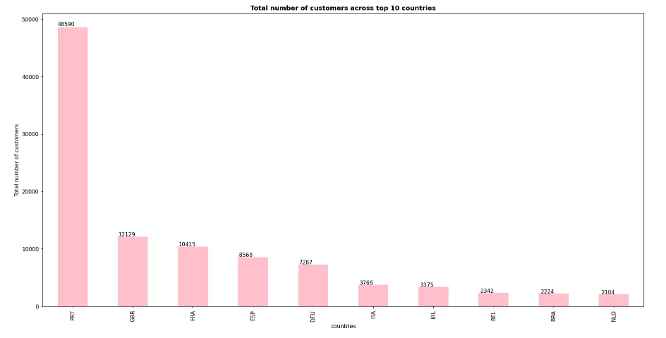
Top 10 Countries With Maximum Customers
Which are those countries giving maximum customers?
So, here is the result – after analysing the dataset we found that Portugal is on Rank 1 with 48590 customers followed by UK, France, Spain, Germany with 12129, 10415, 8568, 7287 customers accordingly. After these 5 topmost countries Italy, Ireland, Belgium, Brazil and Netherlands has 3766, 3375, 2342, 2224 and 2104 customers i.e., Netherlands sits back with lowest number of customers.

Slide 14
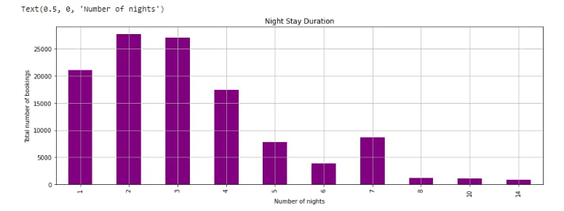
Night Stay Duration
By combining the two columns of stays_in_week_nights and stays_in weekend_nights we got total number of nights. Hence, we can say that more customers like to spend 2 – 3 nights where some customer prefer to stay for 1 – 4 nights. Very few customers are there who are interested to stay for more than 5 days.

Slide 15
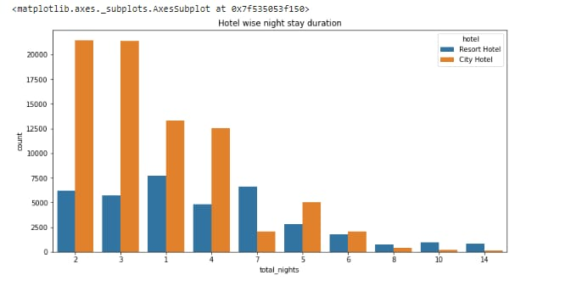
Hotel wise Night Stay Duration
Now we are going to track night stay duration of customers according to Resort hotels and City hotels.
As we already aware that customers loves to stay in City hotels, here also
City hotels have large amount of bookings for 2-3 night stay duration and then 1 night stay and 4 night stay customers are there for City hotels.
In Resort hotels, 1 night stay customers are more and then 7 night stay customers comes in focus. Very few customers likely to stay for 8 night or more than it for both type of hotels.

Slide 16
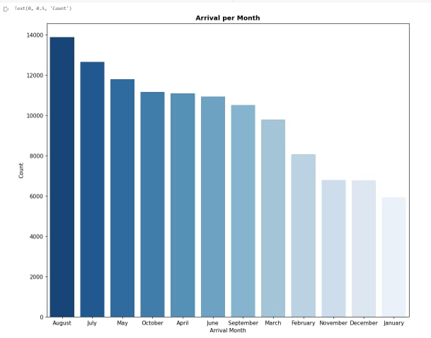
Booking Trend Throught The Year
If we go through booking data along with different months, we found out that August has the highest number of bookings throughout the year then July is at second place where January has the lowest number of bookings i.e., we can assume that January will be the best month for booking to get the best rate on daily basis where booking in month of August will not be economical since it has high demand of room bookings obvious that the cost will also be high.

Slide 17
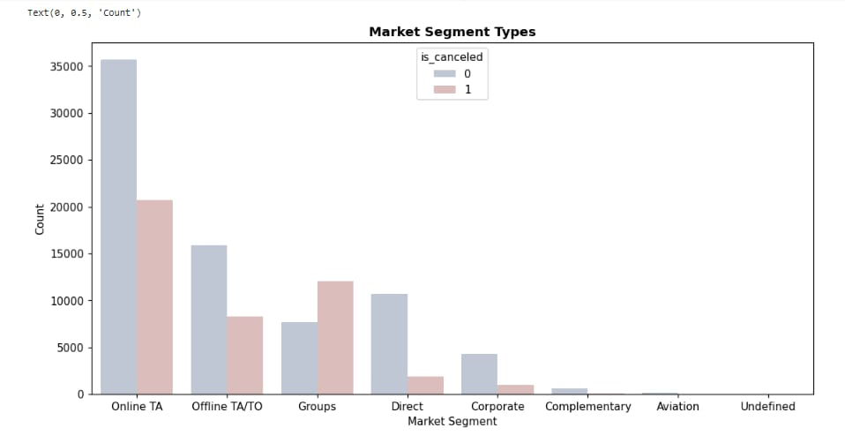
Total Number Of Bookings Across Various Market Segment
Online TA (Travel Agency) segment gives high amount of customers and then Offline TA/TO, Groups, Direct etc. respectively. Complementary, Aviation and Undefined has the lowest amount of customers.
So , from this we conclude that We can target our marketing area to be focus on these travel agencies website and work with them since majority of the visitors tend to reach out to them.

Slide 18
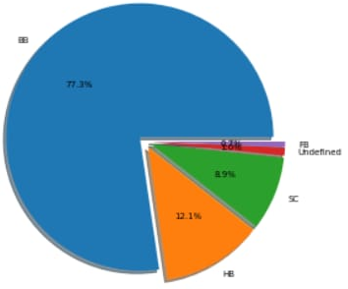
Meal Category vs Count Of Booking
Undefined/SC — no meal package
BB — Bed & Breakfast
HB — Half board (breakfast and one other meal — usually dinner)
FB — Full board (breakfast, lunch and dinner)
Maximum of the bookings are made with bed and breakfast .So, BB type of meal category is the most preferable in all type of customers, where negligible bookings are made with FB type of meal.

Slide 19
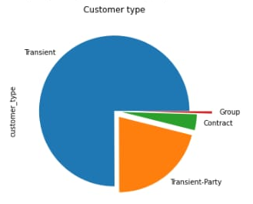
Booking vs Customer Type
Contract — when the booking has an allotment or other type of contract associated to it
Group — when the booking is associated to a group
Transient — when the booking is not part of a group or contract, and is not associated to other transient booking
Transient-party — when the booking is transient, but is associated to at least other transient booking
This means that the booking is not part of a group or contract. With the ease of booking directly from the website, most people tend to skip the middleman to ensure quick response from their booking.
Transient type of customer is the main source of booking because 75% of booking coming from this side after that Transient-Party, Contract and Group are coming in the focus.

Slide 20
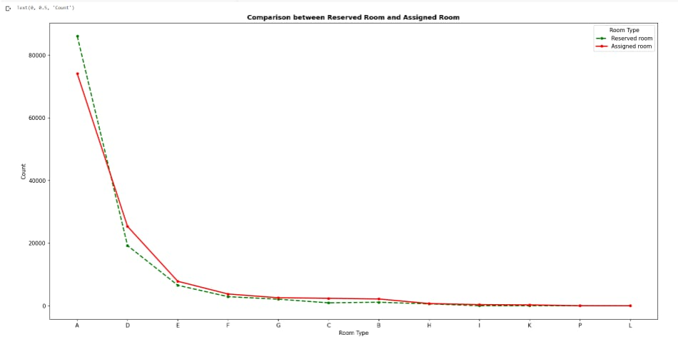
Booking Trend With Respect To Room Type
A - type of room is the most favorite in all types of customers covering all the market about more than 85% ,the D – type of room is at second place in que while negligible customers are there which are ready to stay in L - type and P – type of room.
So we need to upgrade L- type and P – type of room to attract more customers so that no one should be in waiting list and do not search any other hotel which results in increasing the profit of hotels as more customers will book the rooms in the hotels.

Slide 21
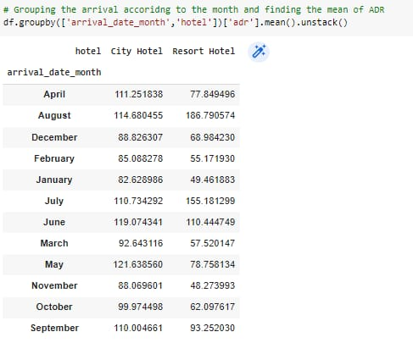
Variation In ADR Across Different Months
For resort hotels, the Average Daily Rate (ADR) is more expensive during August, July, June and September where it is lower for January and November.
For city hotels, the Average Daily Rate (ADR) is more expensive during August, July, May and June where it is lower also for January and November.

Slide 22
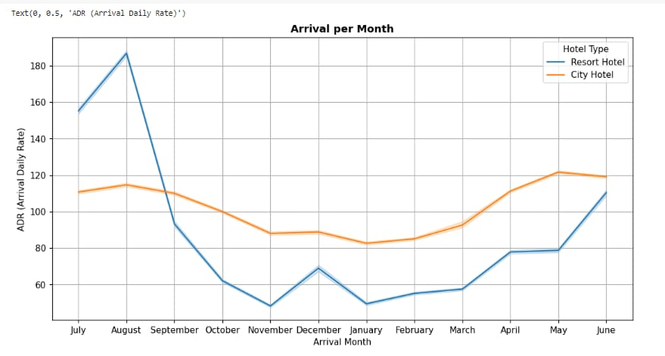
Variation In ADR Across Different Months
So overall Average Daily Rate of both city hotels and resort hotels are more expensive between May and September.

Slide 23
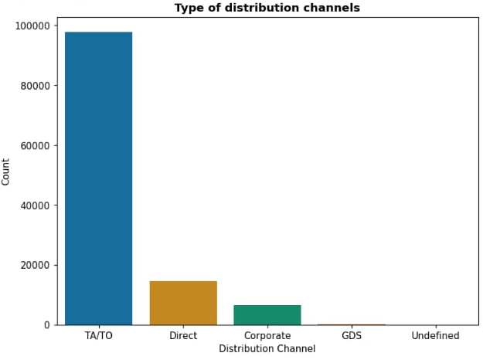
Distribution Channel
From the side graph we observed that most of the customer preferred to book the hotels through TA/TO (Travel agent / Tour operators).

Slide 24
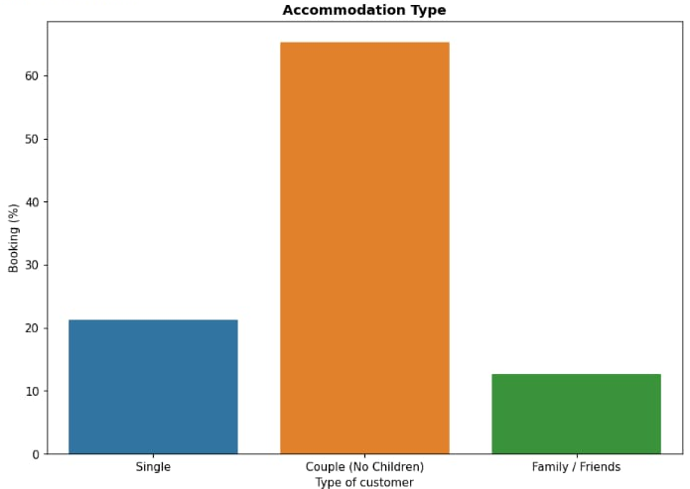
Accommodation Type – Single, Couple & Family
From graph, it is seen that most number of customer are containing 2 adults customer.
And those who have more than 2 either containing adults, children & babies have the lowest number of customer.

Slide 25
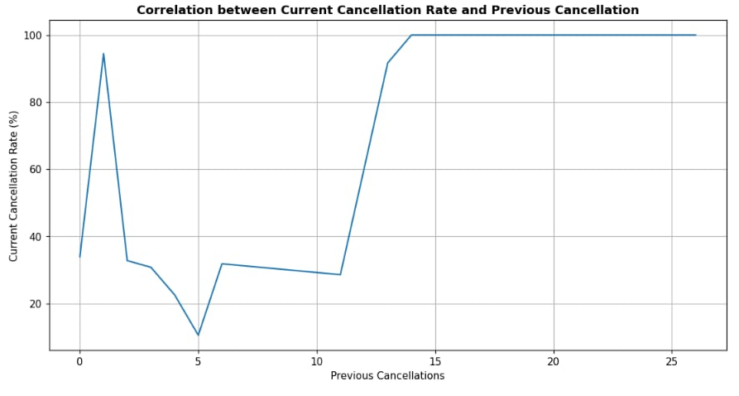
Correlation between previous and current cancellation

Slide 26
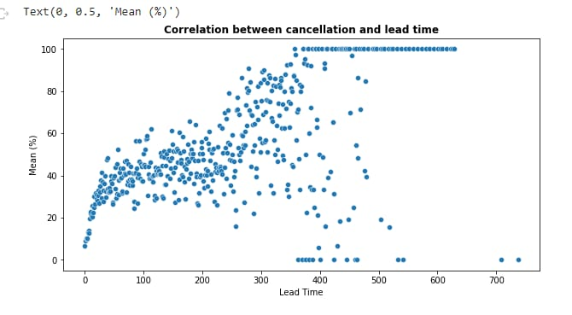
Correlation between cancellation and lead time
When lead time increases lead time also increases.
Positive Correlation between cancellation and lead time.

Slide 27
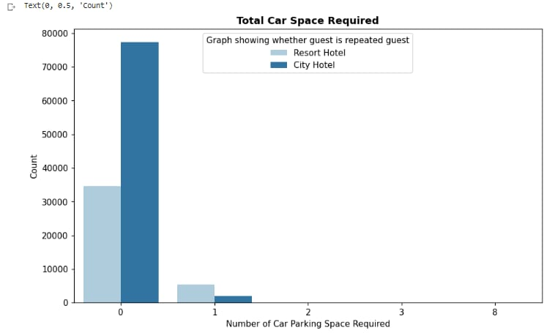
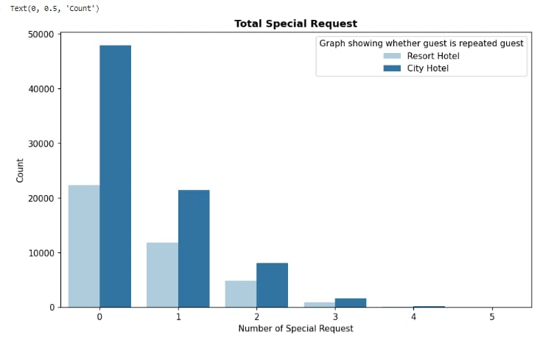
Number of Parking Spaces and Special Requests made by customer

Slide 28
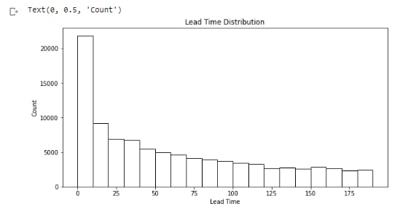
Lead Time Distribution
Bins of this map is from (0,200,10).

Slide 29
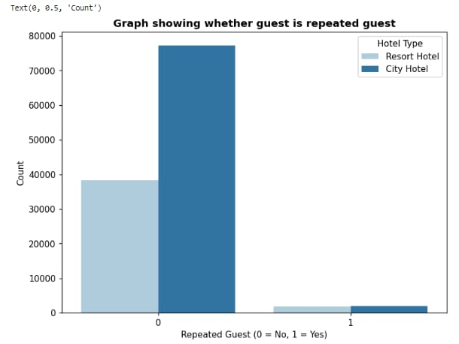
Regular Customer base
This graph shows that only around 3.2% (3806) of customers are regulars.
And around 96.8% (115096) of customers are new.

Slide 30
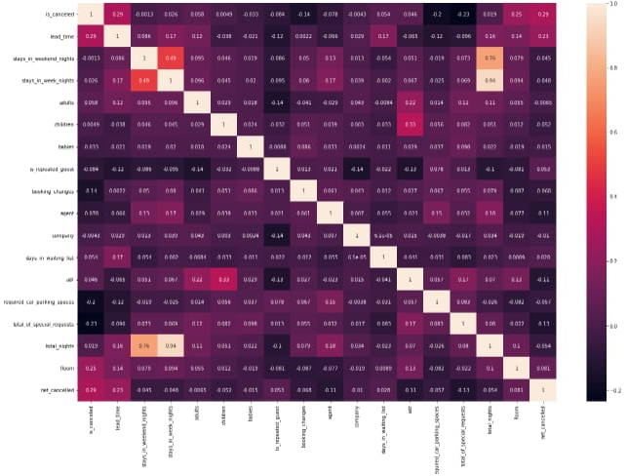
Numerical Column Correlation

Slide 31
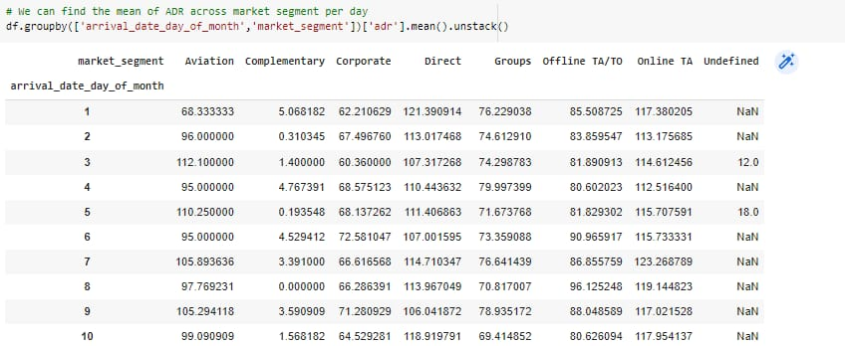
Unstacking of the Data

Slide 32
Conclusion
Majority of the hotels booked are city hotel. Definitely need to spend the most targeting fund on those hotel.
We also realize that the high rate of cancellations can be due high no deposit policies.
We should also target months between May to Aug because these are peak months.
Majority of the guests are from Western Europe. We should spend a significant amount of our budget on those area
Given that we do not have more repeated guests, we should target our advertisement on guests to increase returning guests.

Slide 33
Challenges
1). Huge chunk of data was to be handled by keeping in mind not to miss anything which is even of little relevance.
2). Handling with too many null values and replacing it.

Slide 34
References
https://pandas.pydata.org/
https://matplotlib.org/
https://seaborn.pydata.org/
Geeks for Geeks
Analytics Vidhya
Stack overflow.
Kaggle.

Slide 35
Thank You!

